Slide 1

Module 9 Unit 2
He’s a doctor.

Slide 2
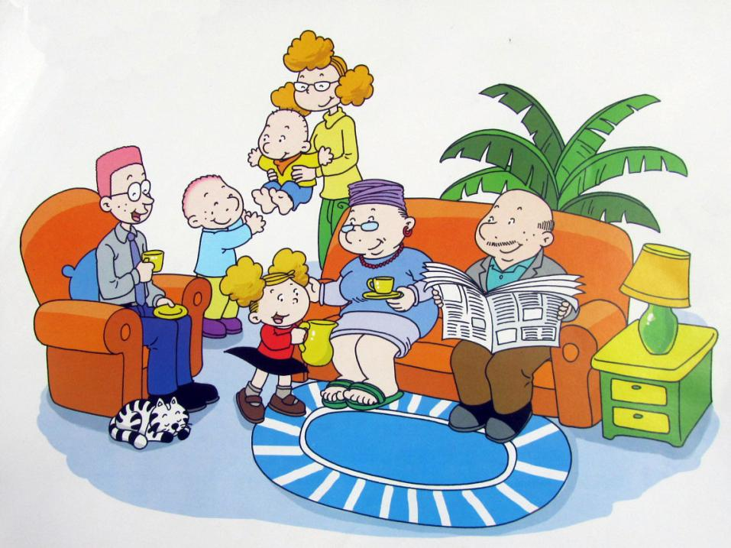
Sam's family
This is .

Slide 3
Daming's family
jobs

Slide 4
1.What's Daming's father do?
A.teacher B. policeman

Slide 5
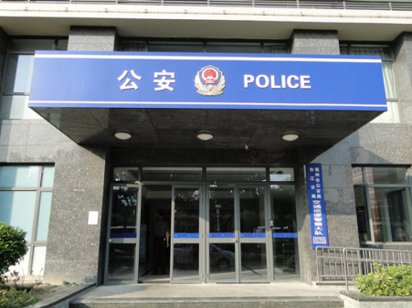
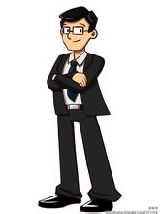
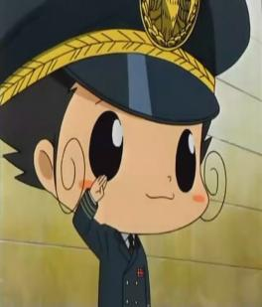
man
＋
PPT模板：www.1ppt.com/moban/ PPT素材：www.1ppt.com/sucai/
PPT背景：www.1ppt.com/beijing/ PPT图表：www.1ppt.com/tubiao/
PPT下载：www.1ppt.com/xiazai/ PPT教程： www.1ppt.com/powerpoint/
资料下载：www.1ppt.com/ziliao/ 范文下载：www.1ppt.com/fanwen/
试卷下载：www.1ppt.com/shiti/ 教案下载：www.1ppt.com/jiaoan/
PPT论坛：www.1ppt.cn PPT课件：www.1ppt.com/kejian/
语文课件：www.1ppt.com/kejian/yuwen/ 数学课件：www.1ppt.com/kejian/shuxue/
英语课件：www.1ppt.com/kejian/yingyu/ 美术课件：www.1ppt.com/kejian/meishu/
科学课件：www.1ppt.com/kejian/kexue/ 物理课件：www.1ppt.com/kejian/wuli/
化学课件：www.1ppt.com/kejian/huaxue/ 生物课件：www.1ppt.com/kejian/shengwu/
地理课件：www.1ppt.com/kejian/dili/ 历史课件：www.1ppt.com/kejian/lishi/
He’s a policeman.
policeman
Notes:
PPT模板：www.1ppt.com/moban/ PPT素材：www.1ppt.com/sucai/
PPT背景：www.1ppt.com/beijing/ PPT图表：www.1ppt.com/tubiao/
PPT下载：www.1ppt.com/xiazai/ PPT教程： www.1ppt.com/powerpoint/
资料下载：www.1ppt.com/ziliao/ 范文下载：www.1ppt.com/fanwen/
试卷下载：www.1ppt.com/shiti/ 教案下载：www.1ppt.com/jiaoan/
PPT论坛：www.1ppt.cn PPT课件：www.1ppt.com/kejian/
语文课件：www.1ppt.com/kejian/yuwen/ 数学课件：www.1ppt.com/kejian/shuxue/
英语课件：www.1ppt.com/kejian/yingyu/ 美术课件：www.1ppt.com/kejian/meishu/
科学课件：www.1ppt.com/kejian/kexue/ 物理课件：www.1ppt.com/kejian/wuli/
化学课件：www.1ppt.com/kejian/huaxue/ 生物课件：www.1ppt.com/kejian/shengwu/
地理课件：www.1ppt.com/kejian/dili/ 历史课件：www.1ppt.com/kejian/lishi/

Slide 6

policeman
policewoman
He’s a .
She’s a .

Slide 7
2.What's Daming's mother do?
A.teacher B. nurse

Slide 8
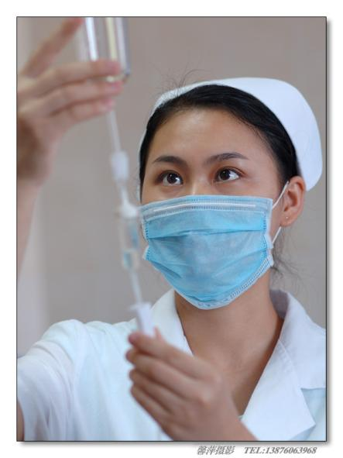
nurse
She’s a .

Slide 9

doctor
He’s a .

Slide 10
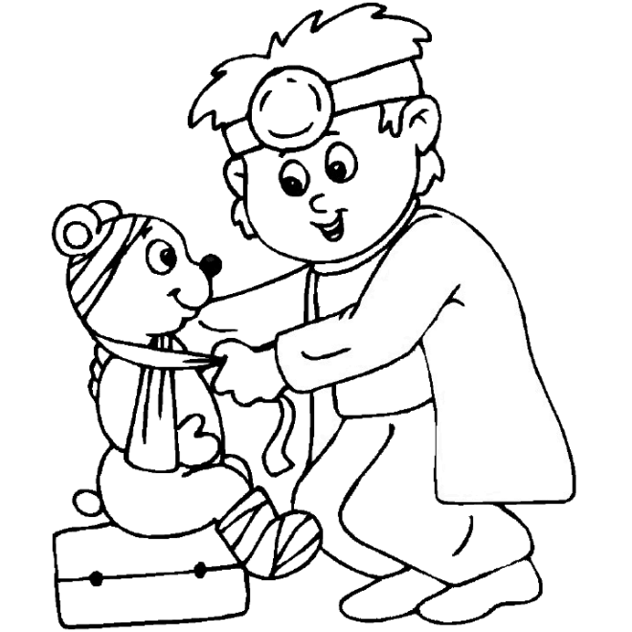
He’s a
doctor.

Slide 11

teacher
She’s a teacher.

Slide 12
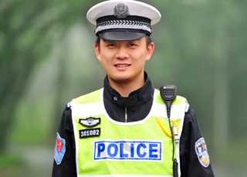


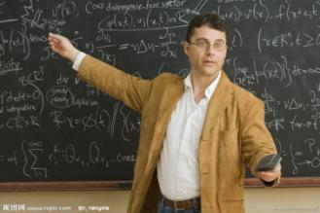
He’ s a… / She’ s a…

Slide 13


陷阱
规则：老师出示图片并说出内容，如果出示的图片和说出的内容一 致，请重复，不一致则闭上嘴巴。

Slide 14
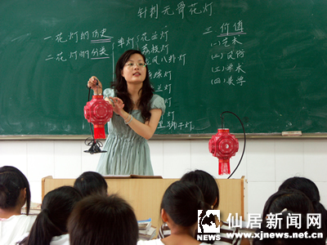
She’s a teacher.

Slide 15

She’s a doctor .

Slide 16
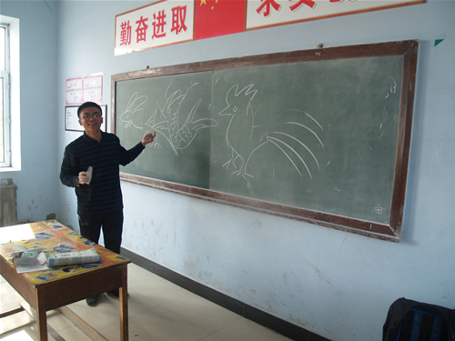
She’s a teacher .

Slide 17
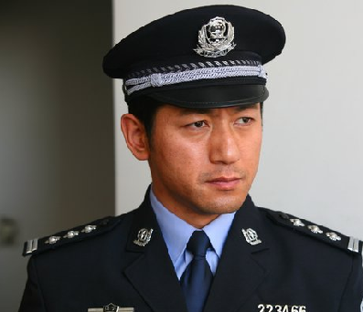
He’s a policeman

Slide 18
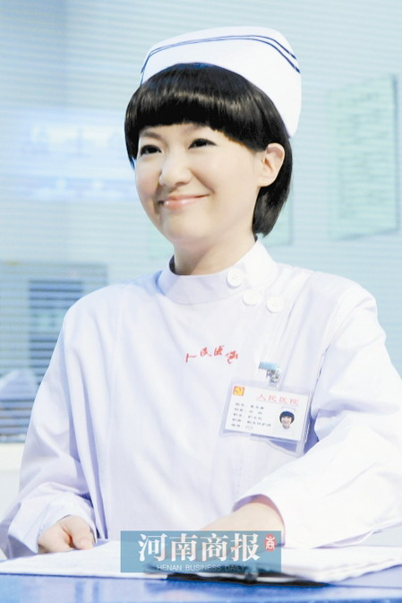
He’s a nurse.

Slide 19
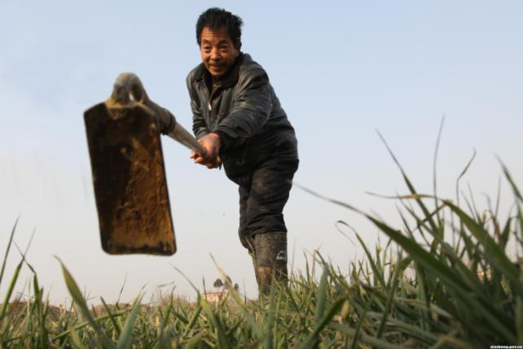
farmer

Slide 20
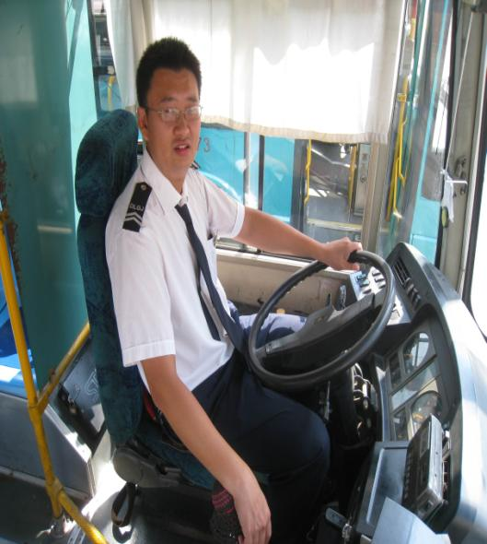
driver

Slide 21
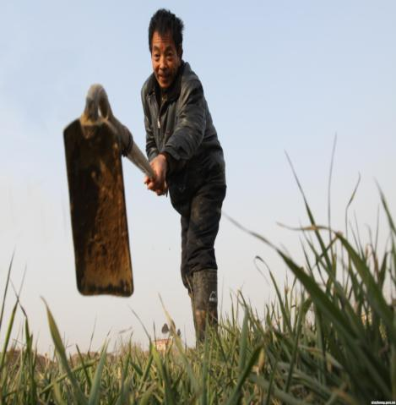
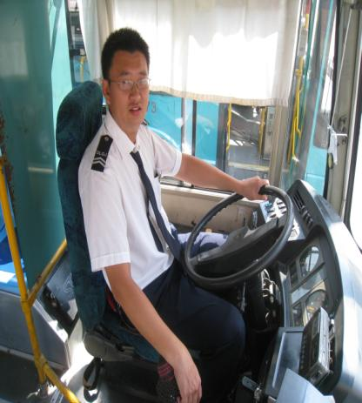
farmer
driver

Slide 22
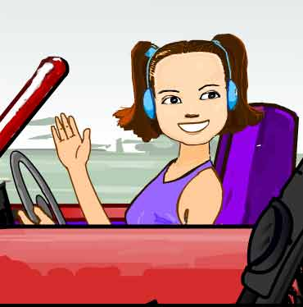
driver
She’s a .

Slide 23

farmer
is a .

Slide 24


What are they ?
A：What's she/he?
B: She/he is________.

Slide 25
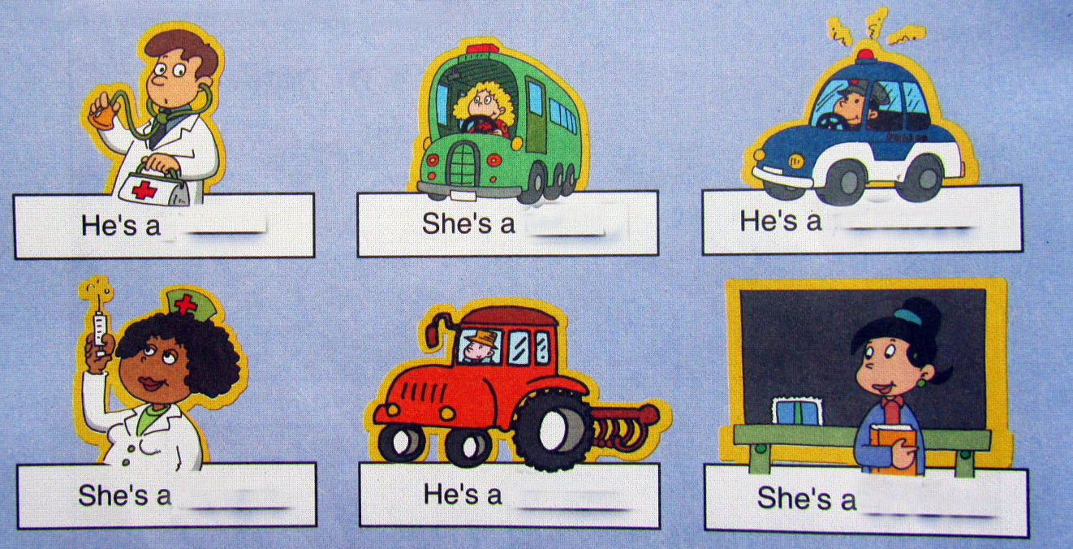

Slide 28
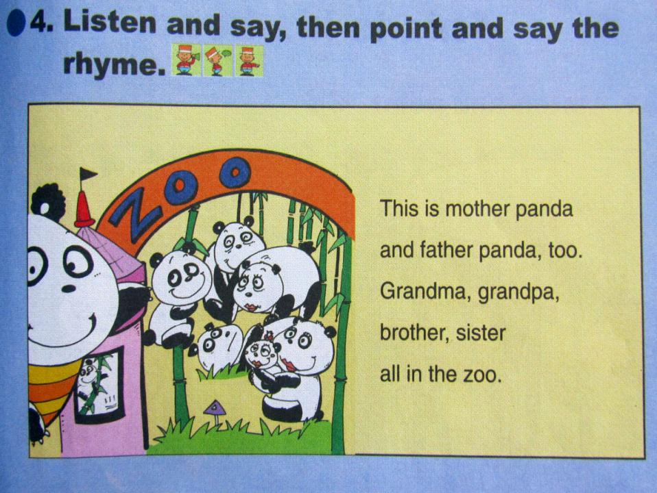


Slide 29

Homework（作业）:
Read the text.(读课文)
2. Draw a family tree ,then tell me what are they?（画一颗家庭树，并告诉老师，你的家人是干什么的？）

Slide 30

Goodbye

Slide 31






He’s a farmer.
He’s a doctor.
She’s a driver.
He’s a policeman.
She’s a teacher.
She’s a nurse.

Slide 32
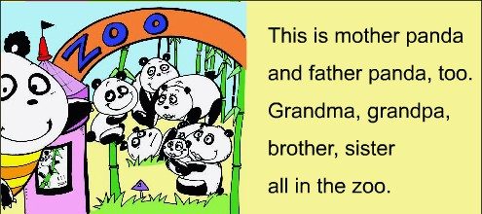

Slide 33
Homework :
If you shill want to speak English, talk to your father and your mother, tell them what you've learnt today.

